Slide 1

Detection of structural edges in photographic images of rooms using machine learning
Yao Xin Meng (U1621203D)

Slide 2
Contents
Introduction
Literature Review
Methodology
Results
Conclusion

Slide 3
Introduction: Background and Motivation
Reconstructing the 3D model of room architecture from photographic images has several applications:
Measuring room dimensions for interior design
Inspection of real estate
The 3D reconstruction process can be broken into 4 steps:
Extracting the relevant structural edges
Structural edges refer to edges between walls, ceiling and floor
Determining the line equation of each edge
Using the line equations to form a wireframe model
Creating the 3D model from the wireframe model
Most Challenging!

Slide 4
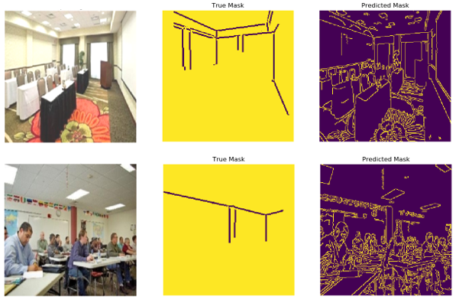
Introduction: Challenge
Extraction of relevant structural edges has previously been done unsuccessfully with classical algorithms such as Canny Edge Finder
These algorithms fail to distinguish between different types of edges
An alternative method for extraction of structural edges is required.

Slide 5
Introduction: Objective and Scope
Machine learning is proposed as an alternative for detecting structural edges in photographic images
The objective of this project is to establish
whether machine learning is a viable solution to the challenge of extracting structural edges in photographs and, if so,
determine the neural network that is most suitable for performing this task

Slide 6
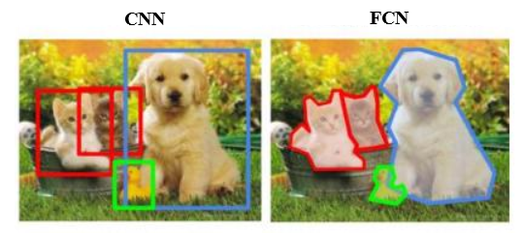
Literature Review: Overview
One form of machine learning is deep learning using neural networks
The two main image-processing neural networks are Convolutional Neural Networks (CNNs) and Fully-Convolutional Networks (FCNs)
CNNs generally have a linear output layer for classifying an entire image
FCNs have a convolutional output layer that attempts to classify each pixel in an image

Slide 7
Literature Review: FCNs
FCNs can identify multiple objects in a single image as well as determine the location, size and shape of each object
This process is known as image segmentation
For the purposes of identifying the structural edges, FCNs are the more suitable choice
There are a few notable FCN architectures that are readily available:
SegNet
U-Net
DenseNet
Transfer Learning with pre-trained FCN-RESNET101

Slide 8
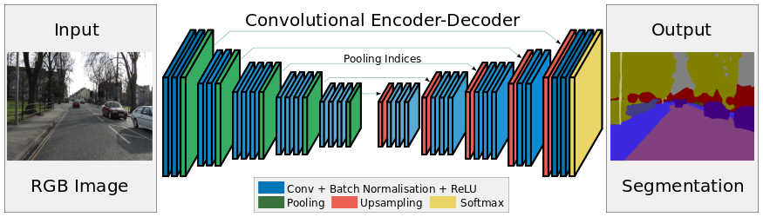
Literature Review: SegNet
SegNet uses cascading modules of encoders followed by cascading modules of decoders to extract key features from an image
Encoders consist of Convolution, Batch Normalization, ReLU (activation function) and Max Pool
Decoders consist of Max Unpool, Convolution, Batch Normalization and ReLU

Slide 9

Literature Review: U-Net
U-Net is similar to SegNet in many ways, but there are 2 key differences
It uses Transposed Convolution instead of Max Unpool for upsampling
The output from each encoder block is cloned and concatenated onto the input of the corresponding decoder block

Slide 10
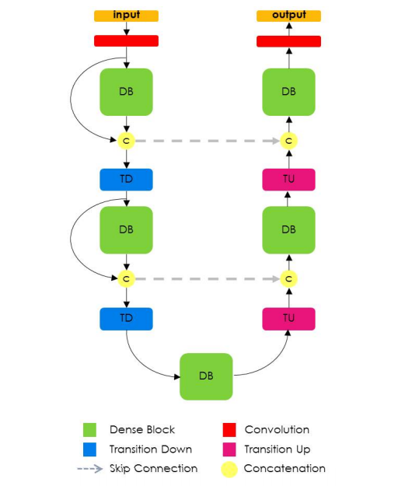
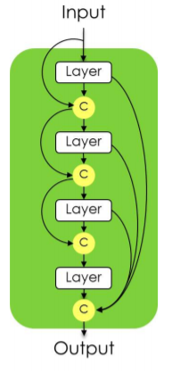
Literature Review: DenseNet
DenseNet is similar to U-net in many ways, but the main difference is that its building block is the Dense Block (DB)
The DB concatenates each input with the output of the next layer and concatenates the outputs of all 4 layers together at the end

Slide 11
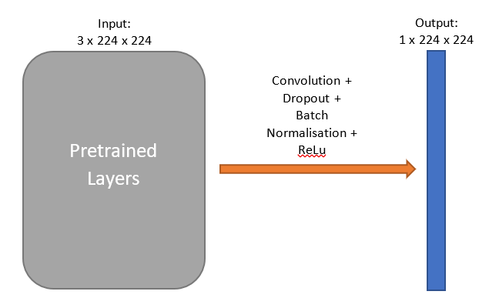
Literature Review: Transfer Learning
Transfer learning refers to using a pre-trained model with only the last few layers modified, so that training can be done much faster
This project uses FCN-RESNET101 as the pre-trained model, which in turn uses ResNet-101 as the backbone.
The model was pretrained on a subset of the Common Objects in Context (COCO) 2017 dataset

Slide 12
Literature Review: Main Libraries
PyTorch | TensorFlow
Developed by Facebook | Developed by Google
Not preferred in industry | Preferred in the industry
Less comprehensive documentation and forums | More comprehensive documentation and forums
Uses a dynamic graph | Uses a static graph
More memory-efficient | Less memory-efficient
Slower runtime | Faster runtime

Slide 13



Literature Review: Other Libraries
Open Source Computer Vision Library (OpenCV)
Vast selection of image processing algorithms
Pygame
Built for users to write video games
Compatible on most systems
Matplotlib
Image visualisation tool

Slide 14
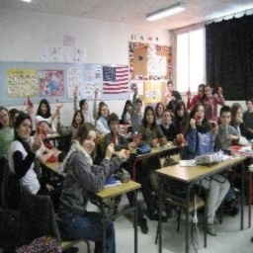
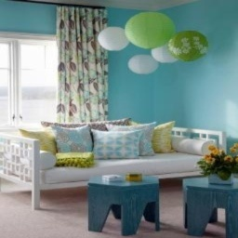
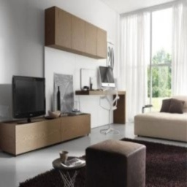
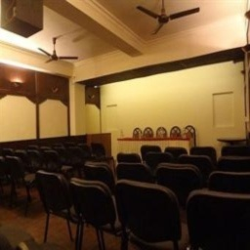
Methodology: Overview
The process of training the model is divided into four parts:
Labelling of data
Data Augmentation
Data Processing
Training the Model
Data was sourced from a scene-centric database used in the LSUN Scene Classification Challenge
Roughly 5,000 images from categories “bedroom”, “classroom”, “conference room” and “living room”

Slide 15
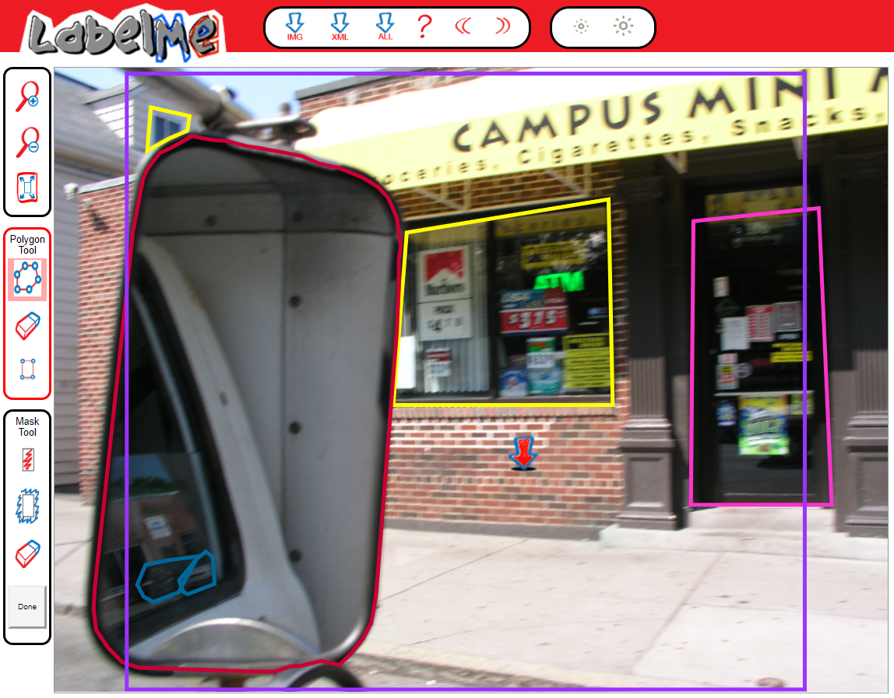
Methodology: Data Labelling Challenges
Data labelling was done by tracing structural edges in each image
Popular online tools such as MIT LabelMe did not have the capabilities suitable for this task
LabelMe only contains polygon tools and is more suited for creating masks over 2D objects
Lack of line tool

Slide 16
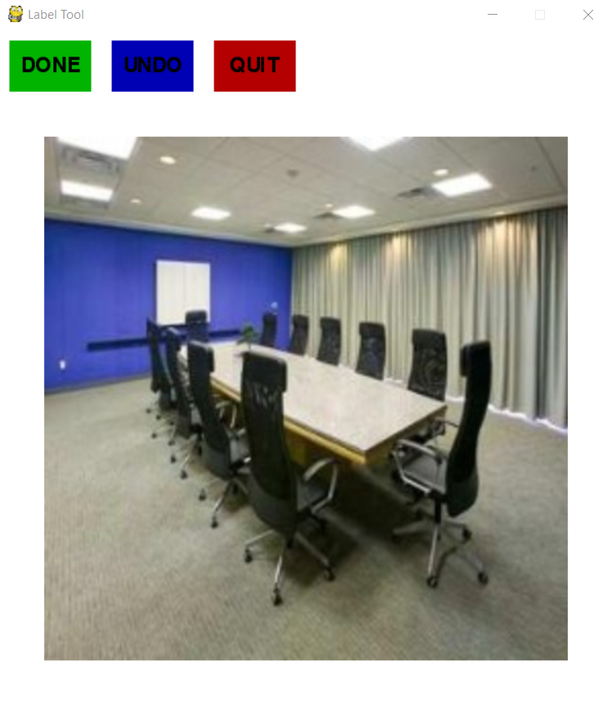
Methodology: Data Labelling
Custom labelling tool was built using Python and the Pygame library
Intuitive GUI
Automatically saves labelled image in specified folder
Programmatically create variations to the types of edges:
1-pixel thick
3-pixel thick
Heatmap

Slide 17
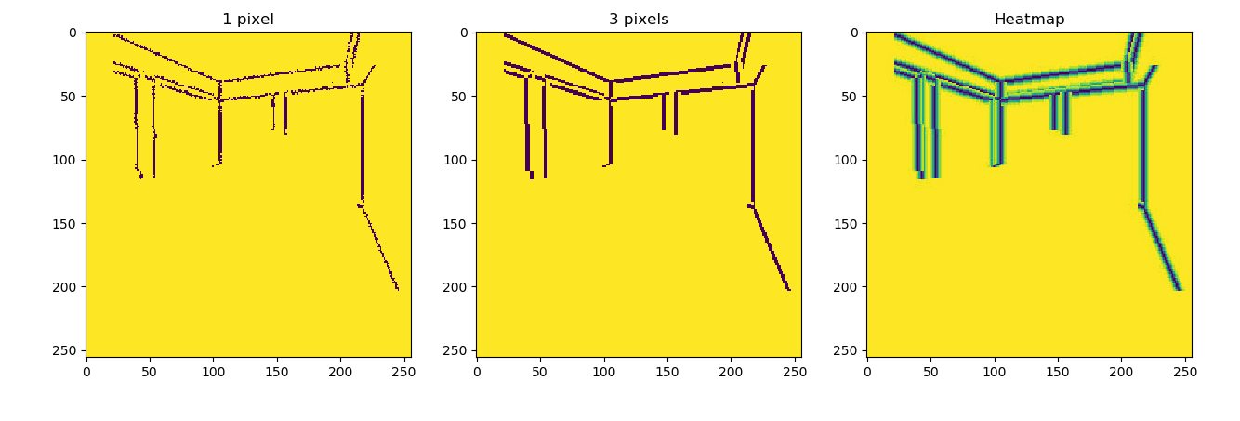
Methodology: Loss functions
A loss function measures the error between the model output and the target value for each pixel
Since edges make up very few pixels in any image, the error will be small
Optimised model might get trapped in a local minimum and generate blank images
Proposed solutions:
A heatmap surrounding each edge
Increase edge thickness to 3 pixels

Slide 18
Methodology: Data Augmentation
Studies have shown that performance increases logarithmically with greater training data size for deep learning models
More data is always better
Data augmentation is required to increase the dataset size of 5,000 images
Using the OpenCV library, all images are subjected to three augmentations

Slide 19
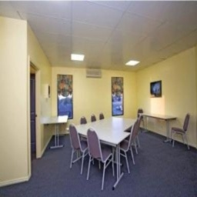
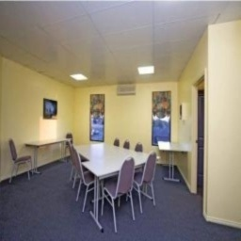
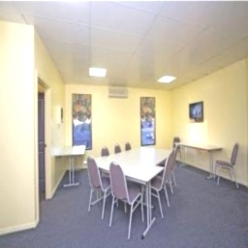
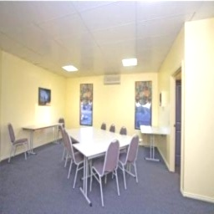
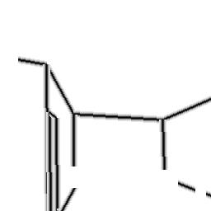
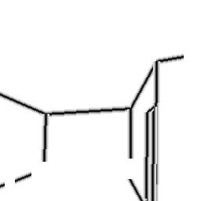

Methodology: Data Augmentation
The augmentations are:
A horizontal flip
An increase in brightness
A horizontal flip plus an increase in brightness
The 20,000 labelled images is further split in a 7:3 ratio to obtain a training set and a test set
Images
Labels

Slide 20
Methodology: Data Processing
Each pixel in an RGB image is an unsigned 8-bit integer [0, 255]
Each pixel in a mask is a 32-bit float [0, 1]
Each pixel in the input image was converted to a 32-bit float with range [0, 1] to ensure that the gradient is uniform as it propagates across the neural network
Further normalisation was intended but it negatively affected the results and was therefore abandoned

Slide 21
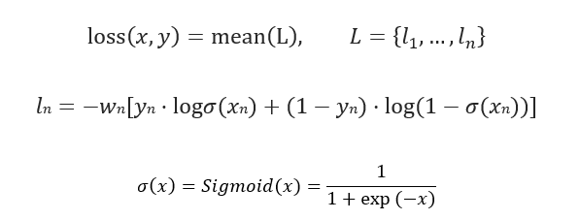
Methodology: Model Training
Loss function: Binary Cross Entropy Loss (BCEWithLogitsLoss)
Optimisation function: Adam with a learning rate = 0.00001
Adam is an optimization algorithm developed in 2014
Number of epochs: 50

Slide 22
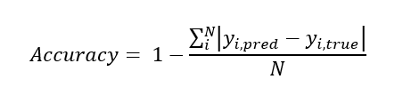
Results: Summary of Model Performance
Model | Loss | Accuracy | Parameters Size (MB)
SegNet | 0.0562 | 0.9616 | 8.75
U-Net | 0.0506 | 0.9683 | 29.38
DenseNet | 0.0436 | 0.9740 | 20.14
Transfer Learning | 0.0252 | 0.9998 | 199.78

Slide 23
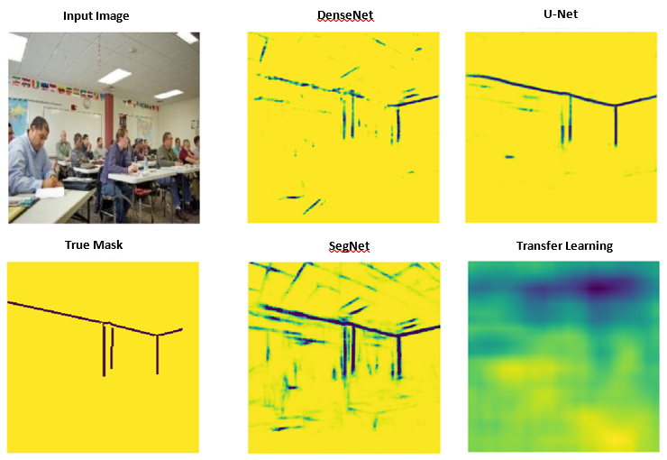
Results: Visualisation of Model Performance
U-Net has the best performance even though DenseNet and Transfer Learning appear to perform best on paper!
The exact reason for this phenomenon is unknown and is beyond the scope of this project

Slide 24
Results: Possible Explanation
Both the evaluation metric (accuracy) and the loss function (loss) might be merely correlated with the performance
A model with good performance will have a high accuracy and low loss
But a model with high accuracy and low loss function may not perform well
Performance
Loss Function
Evaluation Metric

Slide 25
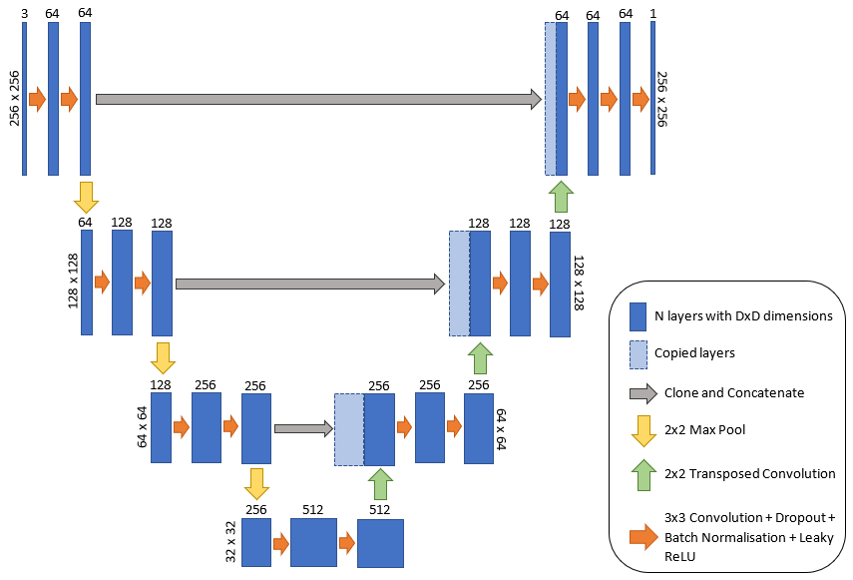
Results: Final Model based on U-Net

Slide 26
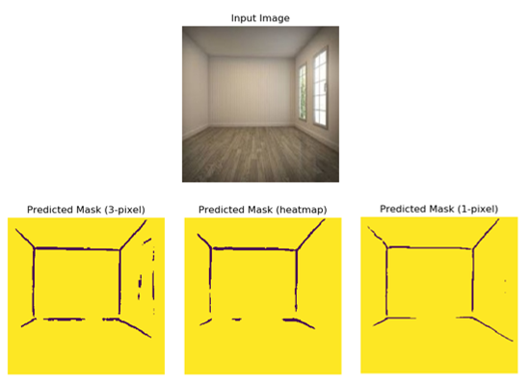
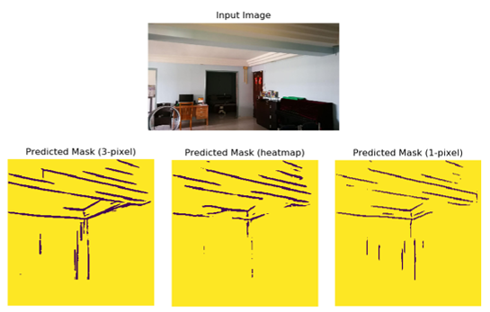
Results: Varying edge types
Three different edge types: 1-pixel, 3-pixel and heatmap edges
The model trained on 1-pixel edges has the best performance

Slide 27
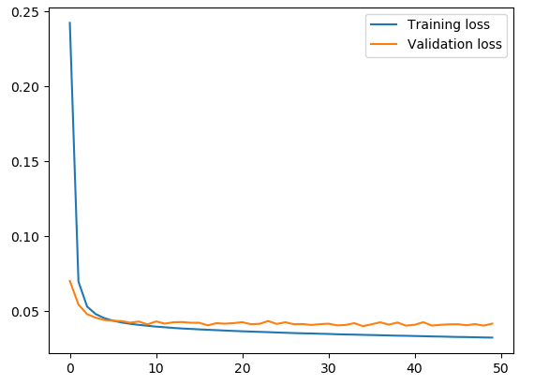
Results: Varying performance with epochs
Training and testing losses are plotted against epochs
The loss obtained for each round of training is slightly different since the training set is shuffled
The number of epochs for minimum loss will be an approximation
The optimal number of epochs occurs around 34
Epoch 35 is chosen for simplicity

Slide 28
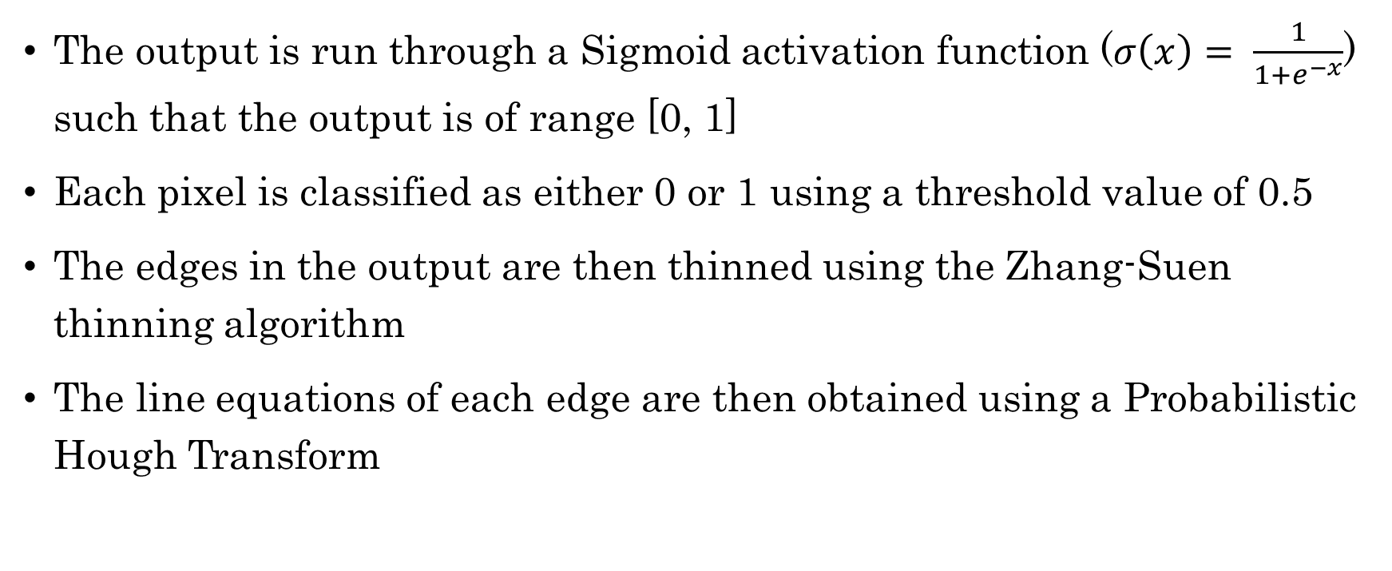
Results: Post-processing
The output is run through a Sigmoid activation function ($σ\left(x\right)= \frac{1}{1+e^{−x}}$) such that the output is of range [0, 1]
Each pixel is classified as either 0 or 1 using a threshold value of 0.5
The edges in the output are then thinned using the Zhang-Suen thinning algorithm
The line equations of each edge are then obtained using a Probabilistic Hough Transform

Slide 29
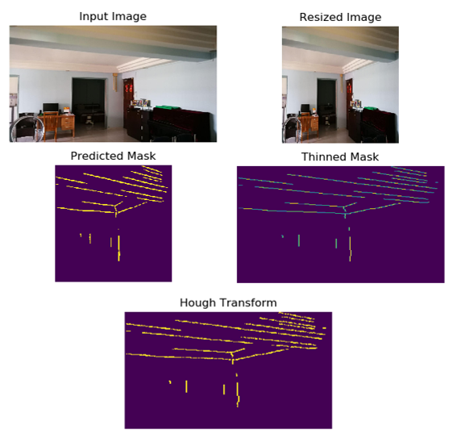
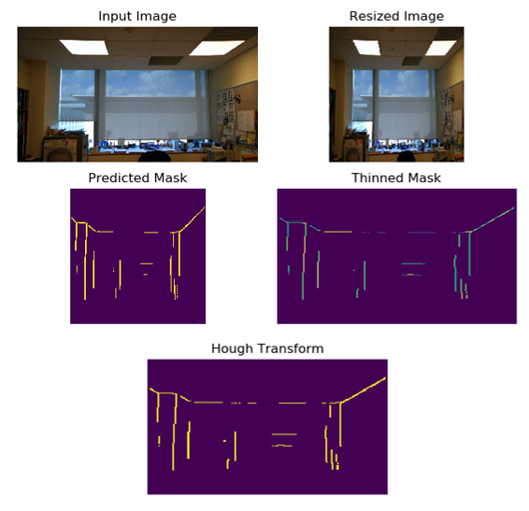
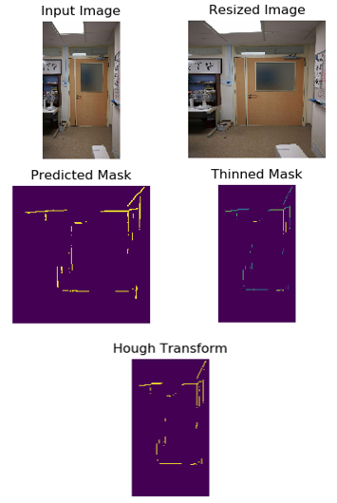
Results: Final Results

Slide 30
Conclusion: Verify Hypothesis
Machine learning in the form of FCN is a viable method for detecting structural edges in photographic images
It performs better than classical algorithms such as the Canny Edge Detector in terms of discriminating relevant edges
The model based on U-Net is shown to be the most promising architecture and has potential to be developed further

Slide 31
Conclusion: Future Work
Improve the model by finetuning some of the hyperparameters
Experiment with other optimisers and learning rates
The current model is not excellent at identifying floor edges
The dataset mostly contains images where the floor edges are hidden by objects and thus has a natural bias
The dataset can be expanded in the future to include more empty rooms
Some edges in the photographs are partially hidden behind objects and are broken into smaller segments
A robust algorithm to extrapolate broken line segments and reconstruct the original line is required in the future

